Slide 1
Lecture 3
Discrete Fourier Transform (DFT)
Aline RUHUMURIZA

Slide 2
Discrete Fourier Transform (DFT)
DFT is very useful for digital computations and for digital hardware implementations.
DFT and its properties: used to perform such tasks as digital filtering and evaluating the frequency response of a linear shift-invariant (LTI) system.
Aline RUHUMURIZA

Slide 3
Outline
Types of signals with analysis tool
Discrete Fourier Transform (DFT)
Inverse DFT (IDFT)
Relation between DTFT and DFT
Properties of DFT
DFT examples
Circle of Value of e^{-j2πnk/4}
DTF using Matrix Equation
Circular Convolution (C C)
Aline RUHUMURIZA

Slide 4
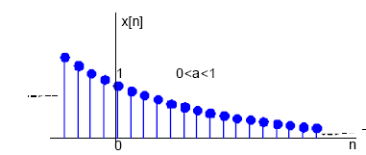

Types of signals with analysis tool
Aperiodic-Continuous
It extends into positive and negative infinity without repeating in a periodic pattern
e.g. y = e^{-x} and y = x²
Tool for Analysis: Fourier Transform (FT).
Aline RUHUMURIZA

Slide 5

Types of signals with analysis tool
Periodic-Continuous
It repeats itself in a regular pattern between positive and negative infinity
e.g. y = sin(x) and square waves.
Tool for Analysis: Fourier series (FS).
Aline RUHUMURIZA

Slide 6
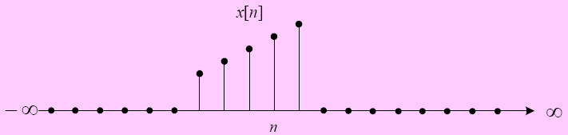
Types of signals with analysis tool
Aperiodic-Discrete
Defined at discrete points between positive and negative infinity not repeating in periodic pattern.
Tool for Analysis: Discrete Time Fourier Transform (DTFT).
Aline RUHUMURIZA

Slide 7
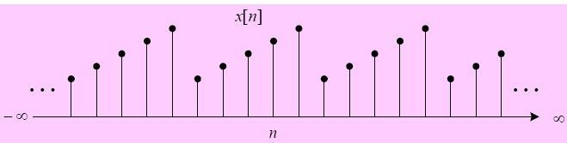
Types of signals with analysis tool
Periodic-Discrete
Discrete signal that repeats itself in a regular pattern between positive and negative infinity.
Tool for Analysis: Discrete Fourier Transform (DFT).
Aline RUHUMURIZA

Slide 8




Discrete Fourier Transform (DFT)
The Discrete Fourier Transform (DFT) converts time domain data to frequency domain data. It decomposes a sequence of values into components of different frequencies.
DFT is to compute the sequence X(k) of x [n]
the Twiddle Factor
Aline RUHUMURIZA

Slide 9
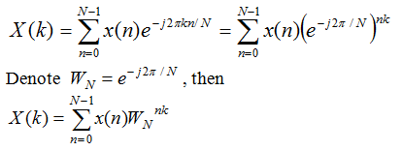
Discrete Fourier Transform (DFT)
Aline RUHUMURIZA

Slide 10
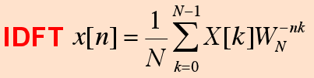
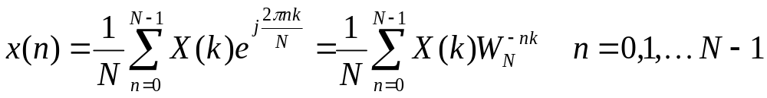
Inverse DFT (IDFT)
The Inverse DFT (IDFT) converts frequency domain data to the time domain. IDFT is to compute the sequence x [n ] of {X(k)}
Aline RUHUMURIZA

Slide 11
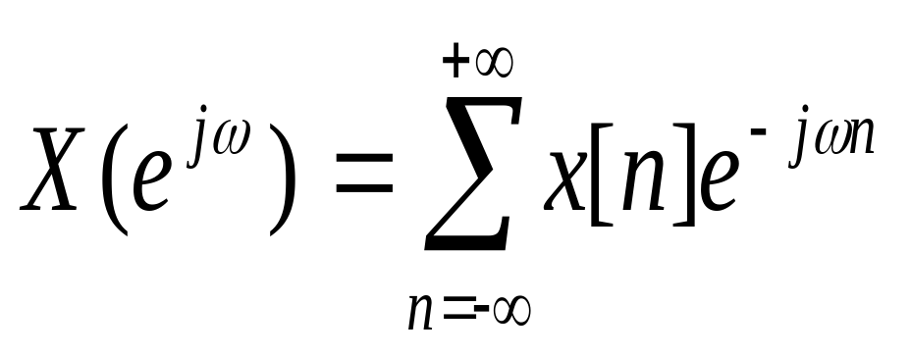
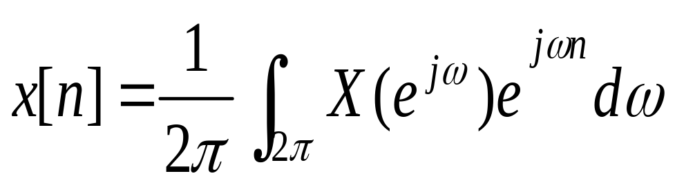

Discrete-Time Fourier Transform(DTFT)
Discrete-time FT:
(DTFT)
Discrete-time inverse FT:
(IDTFT)
The function or X(w) or X(jw) is the Discrete-Time Fourier Transform or spectrum of x[n], a periodic function with period 2π . The pair of equations is referred to as the Discrete-Time Fourier Transform pair.
Aline RUHUMURIZA

Slide 12



DTFT and DFT comparison
DTFT
DFT
w =2 π f and f = 1/ T
and T = N so w = 2 π/N
Aline RUHUMURIZA

Slide 13



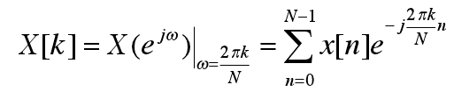
DTFT and DFT comparison
By comparing the two formulas we can write:
As we can conclude that
Therefore,
Aline RUHUMURIZA

Slide 14
DTFT and DFT comparison
DFT
DTFT
Continuous function of w
Sampling is performed
only in time domain
Not computable
numerically based on an
infinite sequence x(n).
Discrete frequency spectrum
Obtained by performing sampling operation both in the time and frequency domain
Numerical operation, with a finite number of coefficients
Aline RUHUMURIZA

Slide 15
Relationship between DFT and DTFT
In spite of their similarities, the DFT and DTFT are two quite different operations.
Whereas the DFT is a numerical operation, which computes a finite number of coefficients X(0); X(1)… ;X(N - 1) from a finite set of data x(0); x(1)… ; x(N - 1)
the DTFT is not computable numerically because it yields a continuous function, X(w), based on an infinite sequence x(n).
Aline RUHUMURIZA

Slide 16


Properties of DFT
1. Linearity :
If DFT{x₁[n]} = X₁(k) and DFT{x₂[n]} = X₂(k) Then DFT{ax₁[n] + bx₂[n]} = a X₁(k) + b X₂(k)
2. Time shift:
3. Frequency shift:
Aline RUHUMURIZA

Slide 17
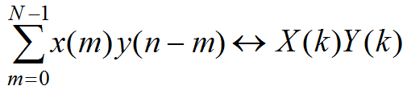
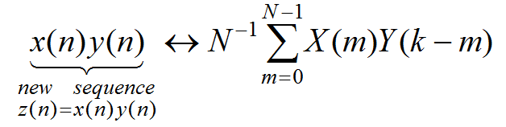
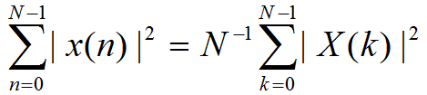
Properties of DFT con’t
4.Circular convolution
5.Multiplication
6. Parseval’s theorem
Aline RUHUMURIZA

Slide 18
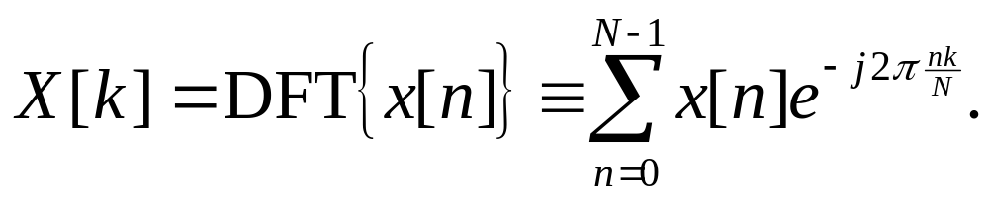
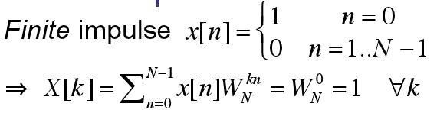
DFT examples
Aline RUHUMURIZA

Slide 19
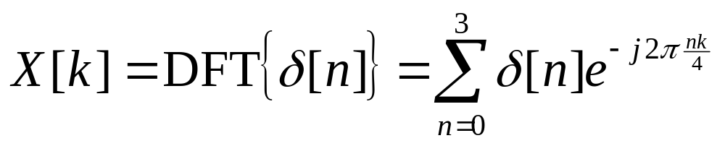
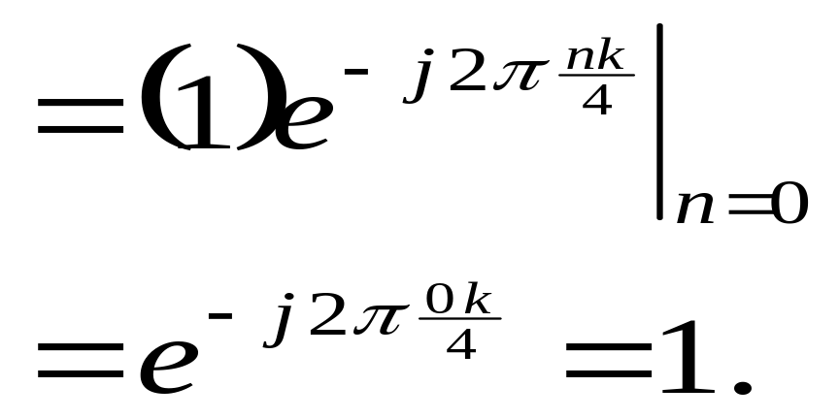
Example 1: Find the discrete Fourier transform of x[n]=δ[n], for N=4.
Result is independent of k.
Aline RUHUMURIZA

Slide 20
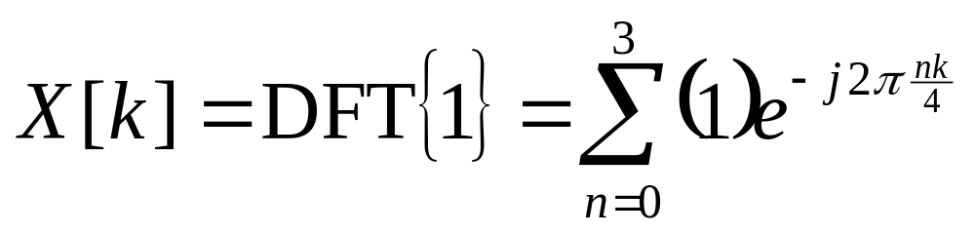
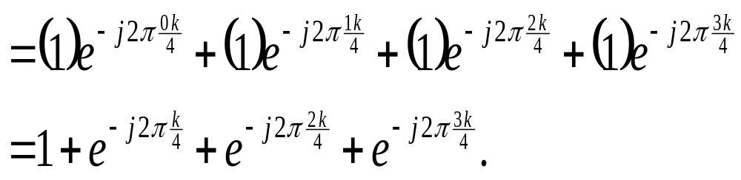
Example 2: DFT of Unit Step Signal
Find the DFT of x[n]=1, for N=4. The values of the time samples are 1, 1, 1, 1(for n=0, 1, 2, 3)
Aline RUHUMURIZA

Slide 21
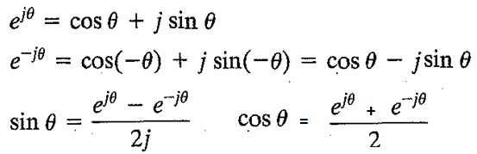
Review Euler formulas
Aline RUHUMURIZA

Slide 22
Symmetry and periodicity of W_{N}^{r} for N=4
W_{N}^{nk} = e^{–jnk2π/N} = cos (2nkπ/N) – j sin(2nkπ/N)
W₄⁰ = e^{-j(2π/4)0} = e⁰ = cos (0) – j sin (0) = +1
W₄¹ = e^{-j(2π/4)1} = e^{-j(π/2)} = cos (π/2) – j sin (π/2) = - j
W₄² = e^{-j(2π/4)2} = e^{-j(π)} = cos (π) – j sin(π) = - 1
W₄³ = e^{-j(2π/4)3} = e^{-j(3π/2)} = cos (3π/2) – j sin(3π/2) = j
W₄⁴ = e^{-j(2π/4)4} = e^{-j(2π)} = cos (2π) – j sin(2π) = 1 = W₄⁰
W₄⁶ = e^{-j(2π/4)6} = e^{-j(3π)} = cos (3π) – j sin(3π) = - 1 = W₄²
W₄⁸ = (W₄⁴)² = 1² = 1 = W₄⁰
Aline RUHUMURIZA

Slide 23
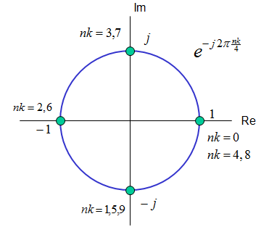
Circle of Value of e^{-j2πnk/4}Phase factors W₄^{kn}
Aline RUHUMURIZA

Slide 24

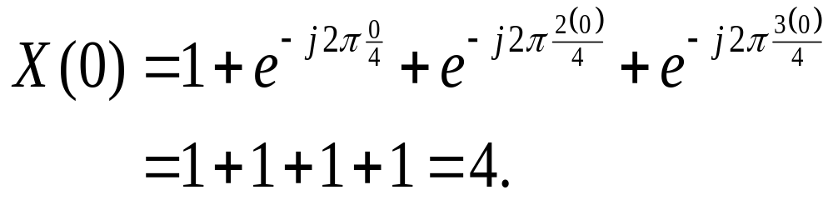
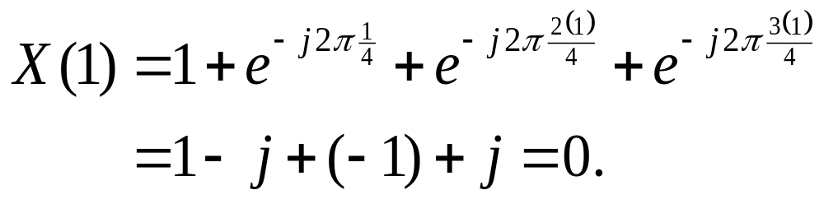
DFT of Unit Step Signal con’t
This result is dependent upon k.
Aline RUHUMURIZA

Slide 25
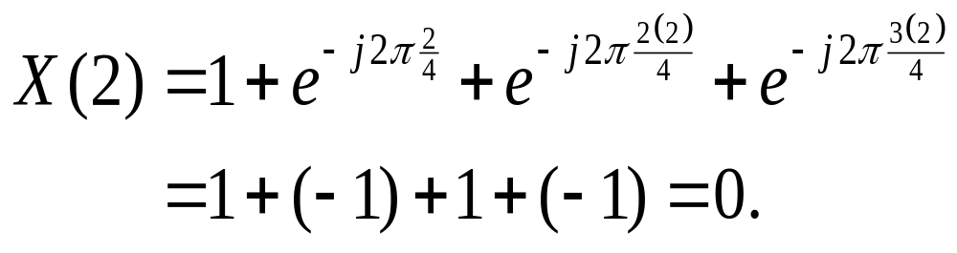
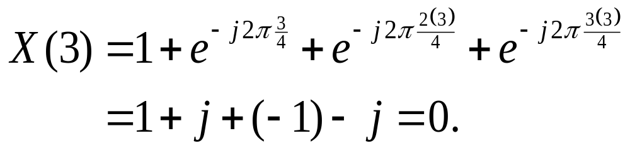
DFT of Unit Step Signal con’t
Aline RUHUMURIZA

Slide 26
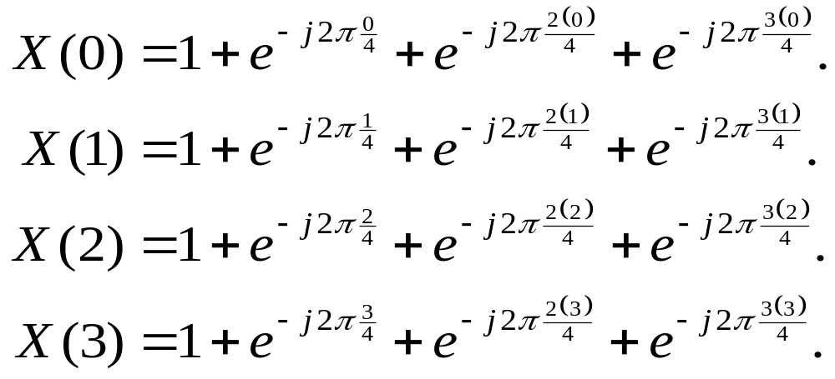
DTF using Matrix Equation
The previous example suggests that the discrete Fourier transform can be calculated using a matrix equation:
Aline RUHUMURIZA

Slide 27
Total computations in DFT/IDFT
  N = 4, 16 multiplications and 12 additions
  16 = 4 ² = N² and 12 = 4 x 3 = N (N -1)
  Each DFT coefficient requires
    N complex multiplications
    N-1 complex additions
  All N DFT coefficients require
    N² complex multiplications
    N(N-1) complex additions
Aline RUHUMURIZA

Slide 28
DFT Algorithm
A DFT decomposes a sequence of values into components of different frequencies. Very slow operation. An N-point DFT takes N² complex multiplications and N(N-1) complex additions. For large values of N, the number of computations becomes very large, so time consuming.
Aline RUHUMURIZA

Slide 29
Calculation Multiplications of DFT
N | Multiplications NxN or N² | Additions N(N-1)
4 | 16 | 12
16 | 256 | 240
64 | 4096 | 4032
256 | 65536 | 65280
1024 | 1,048,576 | 1,047,552
Aline RUHUMURIZA

Slide 30
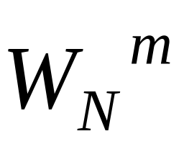
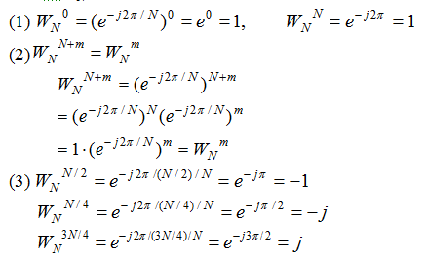
Properties of
Aline RUHUMURIZA

Slide 31
Applying the properties of symmetry and periodicity to W_{N}^{r} for N=4
W_{N}^{nk} = e^{–jnk2π/N} , twiddle factor
= cos (2nkπ/N) – j sin(2nkπ/N)
W₄⁰ = e^{-j(2π/4)0} = cos (0) – j sin (0) = +1
W₄¹ = e^{-j(2π/4)1} = cos (π/2) – j sin (π/2) = - j
W₄² = e^{-j(2π/4)2} = cos (π) – j sin(π) = - 1
W₄³ = e^{-j(2π/4)3} = cos (3π/2) – j sin(3π/2) = j
Aline RUHUMURIZA

Slide 32
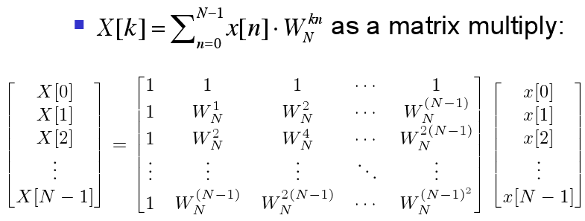
DFT: Matrix Form
Aline RUHUMURIZA

Slide 33
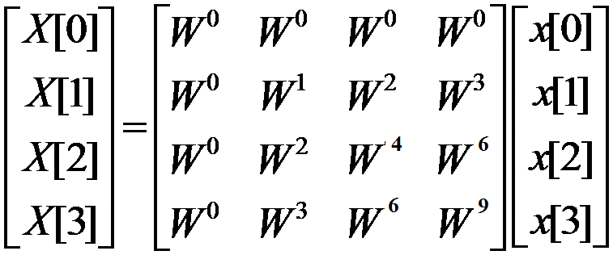
DFT: Matrix Form with N = 4
Aline RUHUMURIZA

Slide 34
Symmetry and Periodicity to W_{N}^{r} for N=4
W_{N}^{nk} = e^{–jnk2π/N} = cos (2nkπ/N) – j sin(2nkπ/N)
W₄⁰ = e^{-j(2π/4)0} = e⁰ = cos (0) – j sin (0) = +1
W₄¹ = e^{-j(2π/4)1} = e^{-j(π/2)} = cos (π/2) – j sin (π/2) = - j
W₄² = e^{-j(2π/4)2} = e^{-j(π)} = cos (π) – j sin(π) = - 1
W₄³ = e^{-j(2π/4)3} = e^{-j(3π/2)} = cos (3π/2) – j sin(3π/2) = j
W₄⁴ = = (W₄²)² = (-1)² = 1 = W₄⁰ = W⁰
W₄⁵ = = W₄¹ x W₄⁴ = (-j) 1 = -j = W₄¹ = W¹
W₄⁶ = = W₄² x W₄⁴ = (-1)(1) = -1 = W₄² = W²
W₄⁸ = ( W₄⁴ ) ( W₄⁴ )= 1² = 1 = W₄⁰ = W⁰
W₄⁹ = W₄¹( W₄⁸ ) = (-j) 1 = - j = W₄¹ = W¹
Aline RUHUMURIZA

Slide 35
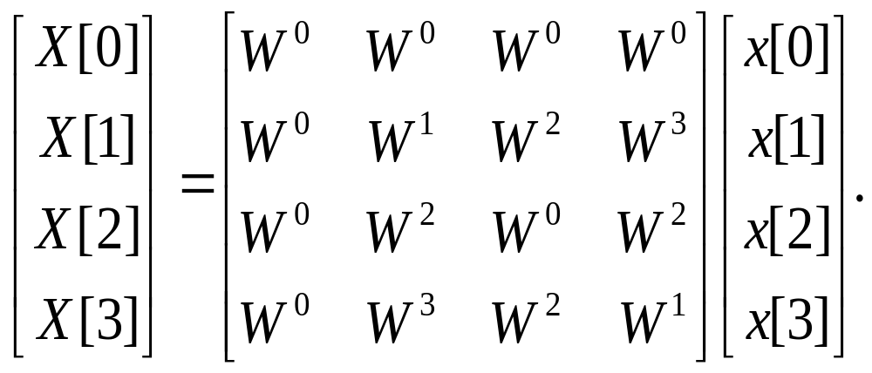
Because of the periodicity of W^{nk}, we have
Aline RUHUMURIZA

Slide 36
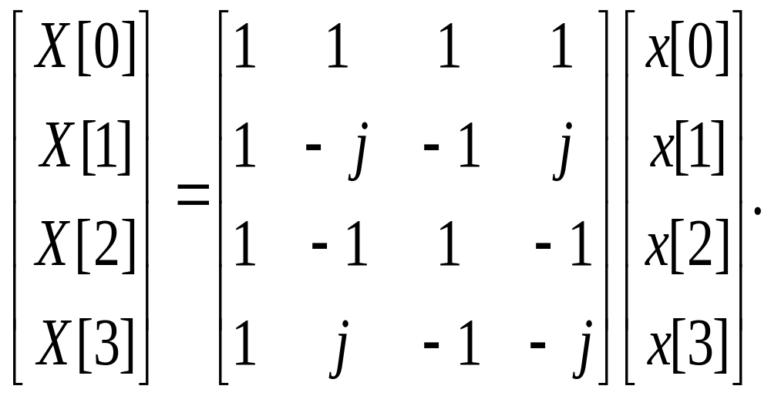
DFT of Unit Step Signal using Matrices
Aline RUHUMURIZA

Slide 37
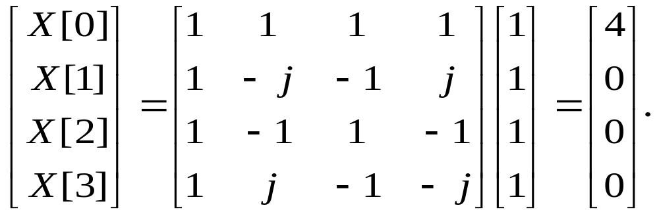
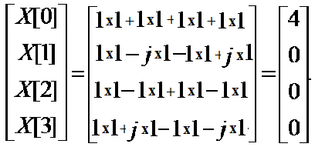
Find the DFT of x[n]=1, for N=4. The values of the time samples are 1, 1, 1, 1(for n=0, 1, 2, 3)
Aline RUHUMURIZA

Slide 38
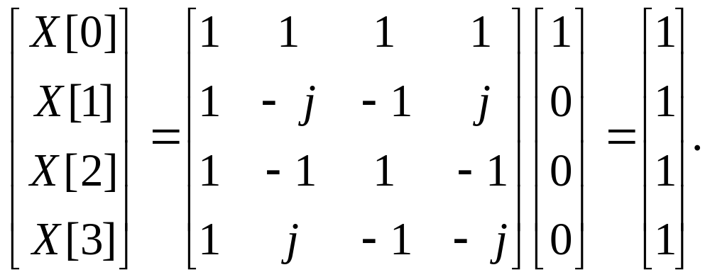
x[n]=δ[n]
Aline RUHUMURIZA

Slide 39

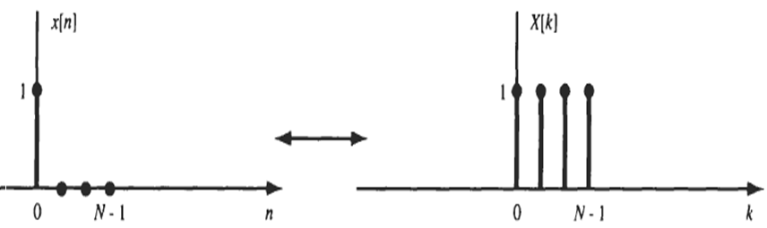
If x[n]=δ[n], X[k] is represented by:
Aline RUHUMURIZA

Slide 40
Circle of Value of e^{-j2πnk/4}Phase factors W₄^{kn}
Aline RUHUMURIZA

Slide 41
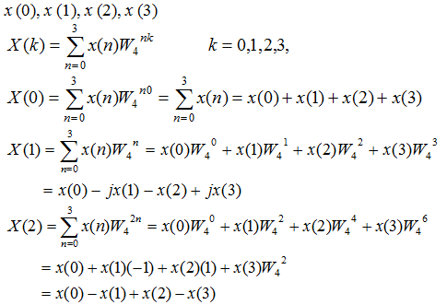
Generalization of derivation to a 4-point DFT
Aline RUHUMURIZA

Slide 42
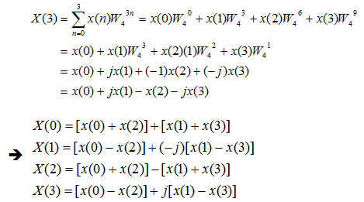
Generalization of derivation to a four-point DFT
Aline RUHUMURIZA

Slide 43
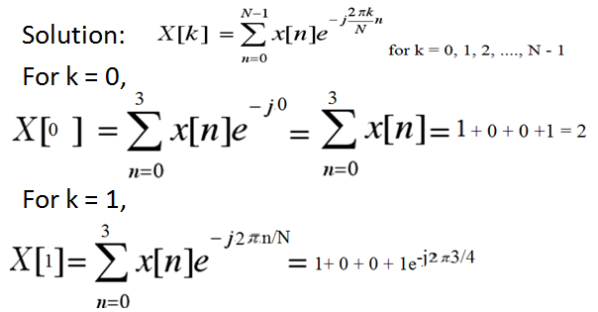
Example : Consider x[n]={1, 0, 0, 1}, obtain its DFT
Aline RUHUMURIZA

Slide 44
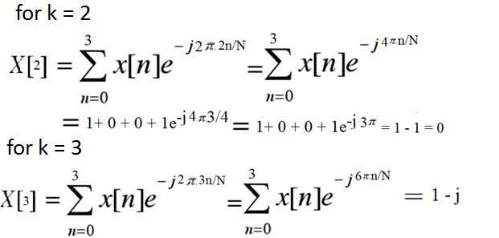
X [k] = {2, 1 +j, 0, 1- j}
Aline RUHUMURIZA

Slide 45
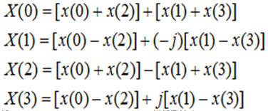
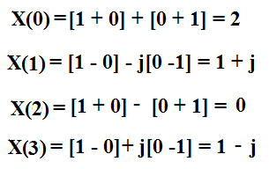
Consider x[n]={1, 0, 0, 1}, obtain its DFT
X [k] = {2, 1 +j, 0, 1- j}
Aline RUHUMURIZA

Slide 46
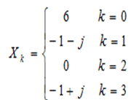
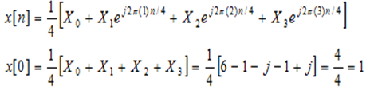
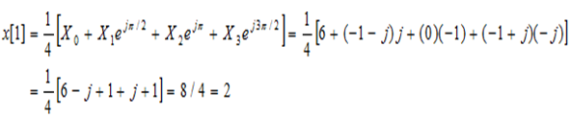
Inverse DFT
Aline RUHUMURIZA

Slide 47
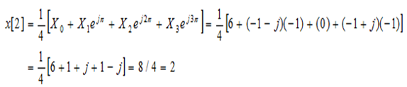
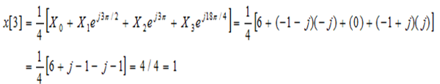

Inverse DFT
Aline RUHUMURIZA

Slide 48
Circular Convolution (for DFT)
For DFT, time domain circular convolution implies frequency domain multiplication, and vice versa.
The circular convolution, also is known as cyclic convolution of two aperiodic functions that occurs when one of them is convolved with a periodic summation of the other function.
Aline RUHUMURIZA

Slide 49
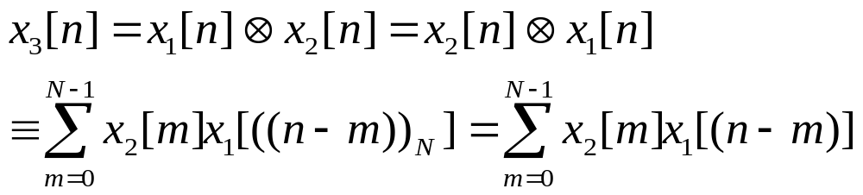
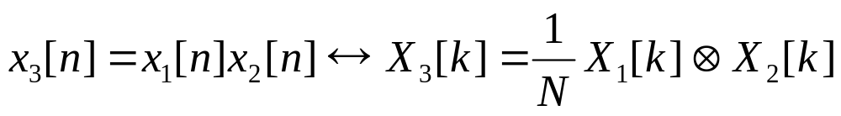
Circular convolution
Symbol for representing circular convolution: ⊗
Time domain circular convolution implies frequency domain multiplication:
Time domain multiplication implies frequency domain circular convolution (with 1/N amplitude reduction):
Aline RUHUMURIZA

Slide 50
Methods used for
Calculating the Circular Convolution
Graphical Method
Using DFT and IDFT
Using Matrices: used in computers.
Conditions of Circular Convolution: Both the
sequences should have the same number of
samples.
Aline RUHUMURIZA

Slide 51
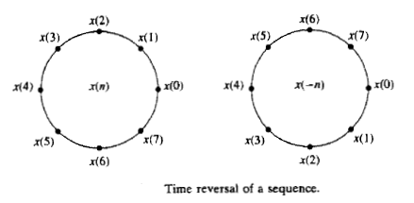
Time reversal of a sequence
Aline RUHUMURIZA

Slide 52


Example
Conditions of Circular Convolution for
performing the circular convolution: both the sequences should have the same number of samples and one must be periodic.
N₁=4 N₂=4
x₁[n] is periodic
Aline RUHUMURIZA

Slide 53
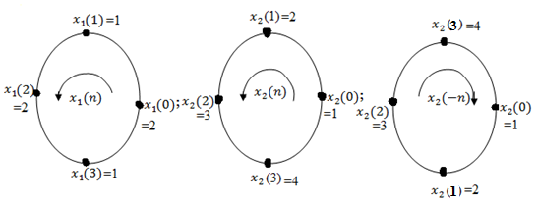
Folded Sequence
The folded sequence is also represented on the circle:
Aline RUHUMURIZA

Slide 54



Solution: Graphical Method
Let be the sequences obtained by circular
convolution of
The folded sequence of x₂[n]
Aline RUHUMURIZA

Slide 55


Aline RUHUMURIZA

Slide 56


Aline RUHUMURIZA

Slide 57


Aline RUHUMURIZA

Slide 58

Aline RUHUMURIZA

Slide 59

Remark
According to the mathematical definition of
circular convolution:
It is clear that circular convolution is
commutative; which means that the following
operation is also possible:
Aline RUHUMURIZA

Slide 60
Circular Convolution
It involves basically the same four steps:
folding (time reversing) one sequence
shifting the folded sequence
multiplying the two sequences to obtain a product sequence
and finally, summing the values of the
product sequence.
Aline RUHUMURIZA

Slide 61

Method 2: Circular Convolution using Matrices
Aline RUHUMURIZA

Slide 62

Circular Convolution using Matrices
Aline RUHUMURIZA

Slide 63



Circular Convolution using Matrices
In our case where
and
The above matrix formula can be used as follows:
Aline RUHUMURIZA

Slide 64

According to the mathematical definition of circular convolution,
It is clear that circular convolution is commutative
Aline RUHUMURIZA

